Slide 1
BINF 4002
Lecture 2: Linear Algebra

Slide 2
Updates
Approximate Syllabus is on Courseworks
V1 of answers for something including the 11 questions from the initial assignment also on Courseworks

Slide 3
Today’s Class: Vector / Vector Space / Linear Operator / Matrix?

Slide 4
Outline
Why do we care (preview)?
Linearity
Vector Spaces
Linear Operators
Bases and Coordinatization
Why do we care?

Slide 5
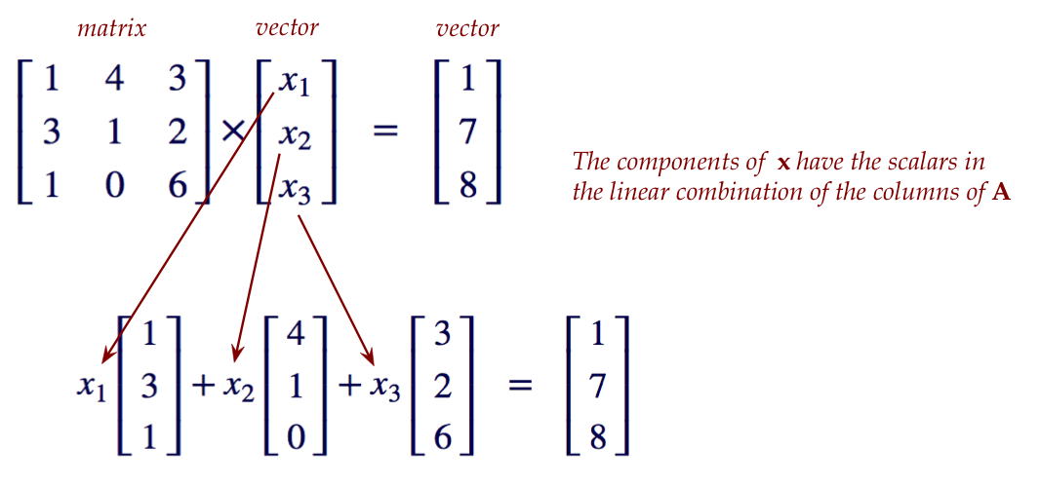
Matrix Multiplication

Slide 6
Additional Things to Look Up
Eigen values and vectors
Singular values and vectors
Matrix vector derivative identities (e.g., what is the derivative of Trace)?
Matrix exponentiation

